Slide 1

Database Management Systems
Shamim Ahmad

Slide 2
Languages
Every task requires extensive programming in a third-generation language (3GL)
  Programmer must specify task and how it must be done
Modern databases use fourth-generation languages (4GL)
  Allow users to specify what must be done without specifying how it is to be done

Slide 3
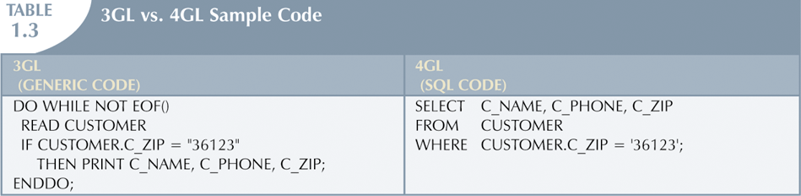
Problems with File System
Data Management

Slide 4
The Database System Environment
Database system is composed of five main parts:
  Hardware
  Software
    Operating system software
    DBMS software
    Application programs and utility software
  People
  Procedures
  Data

Slide 5
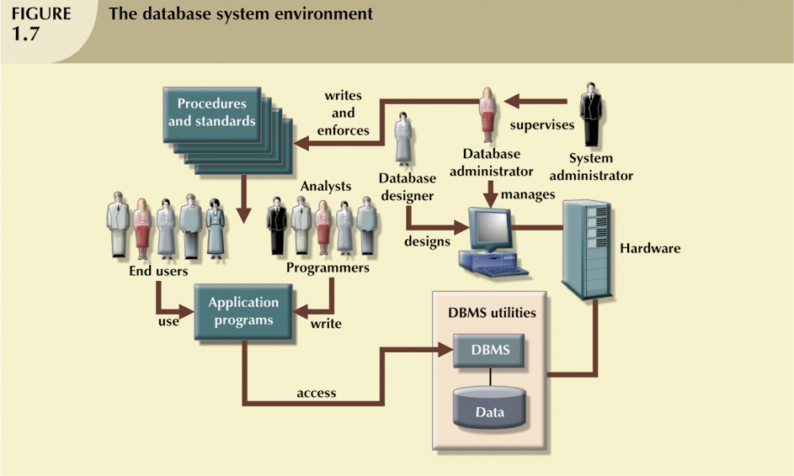
The Database System Environment (continued)

Slide 6
DBMS Functions
DBMS performs functions that guarantee integrity and consistency of data
  Data dictionary management
    defines data elements and their relationships
  Data storage management
    stores data and related data entry forms, report definitions, etc.

Slide 7
DBMS Functions (continued)
  Data transformation and presentation
    translates logical requests into commands to physically locate and retrieve the requested data
  Security management
    enforces user security and data privacy within database

Slide 8
DBMS Functions (continued)
  Multiuser access control
    uses sophisticated algorithms to ensure multiple users can access the database concurrently without compromising the integrity of the database
  Backup and recovery management
    provides backup and data recovery procedures
  Data integrity management
    promotes and enforces integrity rules

Slide 9
DBMS Functions (continued)
  Database access languages and application programming interfaces
    provide data access through a query language
  Database communication interfaces
    allow database to accept end-user requests via multiple, different network environments

Slide 10
Data Abstraction

Slide 11
Data Abstraction
Major aim of a DBMS is to provide users with an abstract view of data
Hides certain details of how the data are stored & maintained
DBMS must retrieve data efficiently
Need for efficiency has led designers to use complex data structures to represent the data in the database
Most DB users are not computer trained, developers hide complexity through several levels of abstraction to simplify user’s interaction with the systems

Slide 12
Levels of Abstraction
Physical level describes how a record (e.g., customer) is stored.
Logical level: describes data stored in database, and the relationships among the data.
type customer = record
name : string;
street : string;
city : integer;
end;
View level: application programs hide details of data types. Views can also hide information (e.g., salary) for security purposes.

Slide 13
Levels of Abstraction
Physical level describes how a record (e.g., customer) is stored.
Logical level: describes data stored in database, and the relationships among the data.
type customer = record
name : string;
street : string;
city : integer;
end;
View level: application programs hide details of data types. Views can also hide information (e.g., salary) for security purposes.

Slide 14
3 Levels of Abstraction
Logical or Conceptual Level
  Describes what data are stored in the DB & what relationships exist among those data
  Describes the entire DB in terms of relatively simpler structures
  Implementation of these simple structures at this level may involve complex physical-level structures
  Users of the logical level need not be aware of this complexity
  DBAs, who decide what information to keep in DB, use the logical level of abstraction

Slide 15
Levels of Abstraction
Many views, single conceptual (logical) schema and physical schema.
  Views describe how users see the data.
  Conceptual schema defines logical structure
  Physical schema describes the files and indexes used.
View 1
View 2
View 3
Conceptual Schema
Physical Schema
Schemas are defined using DDL; data is modified/queried using DML.

Slide 16
ANSI/SPARC 3-Tier Architecture
User 1
User 2
User n
External Level
View 1
View 2
…
View n
E/C Mapping
Logical DI
Conceptual/Logical Level
Conceptual Schema
Physical DI
C/I Mapping
Internal Level
Physical Schema
Database

Slide 17
Instances & Schemas
Collection of information stored in the DB at a particular moment is called an INSTANCE
The overall design of the DB is called a SCHEMA
A DB has many schemas
  Physical
  Conceptual/Logical
  Sub-schemas

Slide 18
Example: University Database
Logical schema:
  Students(sid: string, name: string, login: string, age: integer, gpa:real)
  Faculty(fid:string, fname:string, sal:real)
  Courses(cid: string, cname:string, credits:integer)
  Enrolled(sid:string, cid:string, grade:string)
Physical schema:
  Relations stored as unordered files.
  Index on first column of Students.
External Schema (View):
  Course_info(cid:string,fname:string, enrollment:integer)
Notes:
7

Slide 19
Data Models
A collection of tools for describing
  data
  data relationships
  data semantics
  data constraints
Entity-Relationship model
Relational model
Other models:
  object-oriented model
  semi-structured data models
  Older models: network model and hierarchical model

